Slide 1
A Study of a Positive Fragment of Path Queries: Expressiveness, Normal Form and Minimization
Yuqing Wu, Dirk Van Gucht Indiana University
Marc Gyssens Hasselt University
Jan Paredaens University of Antwerp
TexPoint fonts used in EMF.
Read the TexPoint manual before you delete this box.: AA

Slide 2
Research in XML
XML data model
XML query languages
  XPath
  XQuery
  ……
XML data repositories
  Support from DB vendors
  LORE, Niagara, TIMBER……

Slide 3
Research in XML
Characteristics of XML query languages
  XPath and fragments
  Characteristics: expressiveness, distinguishibility, complexity, …
System design
  Query processing and evaluation
    New access methods: structural join
  Integrity, security, ……

Slide 4
Theoretical Study ←→ System Design
RDB did very well in this aspect
Our work at Indiana University
  Coupling the theoretical study of XML data and query language and the system design of XML search engines [ICDT-EROW 07]
  Coupling the partition of XML documents induced by the structure of XML document with the partition induced by fragments of XPath algebras. [DBPL 07, IS 08]
  Applying the coupling in the design of structural indices for XML [WebDB 08]
  Designing workload sensitive structural indices for XML. [in submission]

Slide 5
Outline
What we studied
Equivalences of query languages
Normal form
Resolution expressiveness
Efficient query evaluation
Summary and discussion

Slide 6
Outline
What we studied
  XML documents
  Path⁺ algebra
  Tree queries
Equivalences of query languages
Normal form
Resolution expressiveness
Efficient query evaluation
Summary and discussion

Slide 7
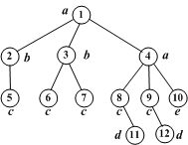
XML Documents
A labeled tree (V, Ed, λ), where
  V is the set of nodes
  Ed is the set of edges
  λ : V→L is a node-labeling function.

Slide 8
Querying XML Document
for $i in doc(…)//a/b
for $j in $i/c/*/d[e]
for $k in $j/*/f
return ($i, $k)
intersect
for $i in doc(…)//a/b
for $j in $i/c/a/d
for $k in $j/c/f
return ($i, $k)

Slide 9
Path⁺ Algebra – Path Semantics

Slide 10
Path⁺ Expression – An Example
E(D) = {(n₈,n₁₁), (n₈,n₁₂)}

Slide 11
Interesting Sub-languages
Path⁺ :
Path⁺(Π₁, Π₂) :
DPath⁺(Π₁) :

Slide 12
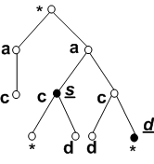
Tree Query for XML
A tree query T is a 3-tuple (T, s, d), with
T: a labeled tree – nodes of T are either labeled with a symbol of L or with a wildcard *.
s and d: nodes of T, called the source and destination nodes.

Slide 13
Outline
What we studied
Equivalences of query languages
Normal form
Resolution expressiveness
Efficient query evaluation
Summary and discussion

Slide 14
Equivalences of Query Languages
Theorem
The query languages Path⁺ , T and Path⁺(Π₁, Π₂) are all equivalent in expressive power, and there exist translation algorithms between any two of them.

Slide 15
Path⁺ Expression → Tree Query T
*
s
*
l
d
*
d
*
s
*

Slide 16
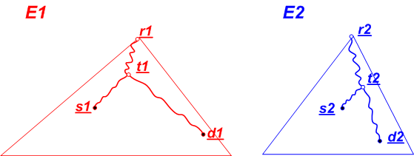
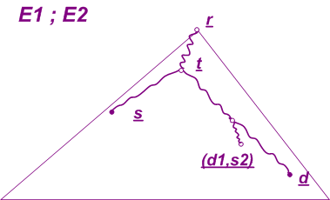
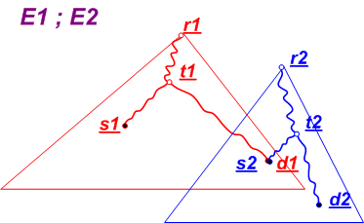
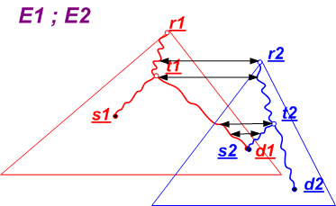
Transformation of Composition

Slide 17
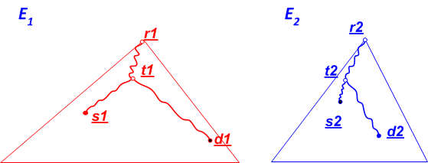
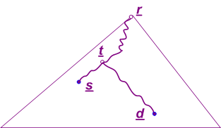
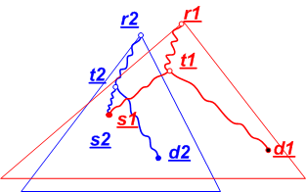
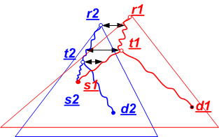
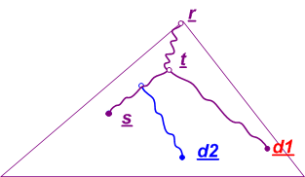
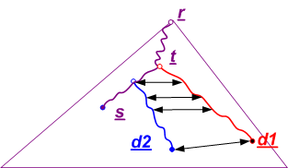
Transformation of Intersection
E₁ ∩ E₂

Slide 18
Tree Query T → Path⁺ Expression
Base cases:
  Empty tree
  (<{n},φ>, n,n)
  (<{n₁, n₂},{(n₁, n₂)}>, n₁, n₂)
  (<{n₁, n₂},{(n₁, n₂)}>, n₂, n₁)
s (d)
l
s (d)
s
d
d
s

Slide 19
Tree Query T → Path⁺ Expression
Recursive case #1: s is not an ancestor of d.
  s has no child and λ(s)=*
  d is parent of s, d has no ancestor,
  no other child and λ(d)=*
p
s
s
T₂
T₁
d
d

Slide 20
Tree Query T → Path⁺ Expression
r
r
Recursive case #2: s is not the root.
  s has no child and λ(s)=*
s
s
T₂
T₁
d
d

Slide 21
Tree Query T → Path⁺ Expression
s
s
Recursive case #3: s is a strict ancestor of d.
  d has no child and λ(d)=*
  s is parent of d, s has no child
  other than d and λ(d)=*
T₂
p
d
d
T₁

Slide 22
Tree Query T → Path⁺ Expression
Recursive case #4: s = d is the root.
  λ(s)=*
s, d
s, d
…
c₁
c_{n}
T₁
T_{n}

Slide 23
Equivalences of Query Languages
Theorem
The query languages Path⁺ , T and Path⁺(Π₁, Π₂) are all equivalent in expressive power, and there exist translation algorithms between any two of them.
Path⁺ exp → T query → Path⁺(Π₁, Π₂) exp

Slide 24
Outline
What we studied
Equivalences of query languages
Normal form
Resolution expressiveness
Efficient query evaluation
Summary and discussion

Slide 25
Normal Form
r
t
s
d
Observation about the tree query → Path⁺(Π₁,Π₂) transformation:
  The resultant Path⁺(Π₁,Π₂) expression is of the form
  where
  m≥0 and n ≥0
  C_{i} (i = u_{m} ,…, u₁, d₁ ,…, d_{n}) are of the form
  C_{top} is of the form
    E is a DPath⁺(Π₁) expression.

Slide 26
Normal Form
E(T_{ts}) ⁻¹; E(T_{tt}) ; Π₂ (E(T_{rt})); E(T_{td})
E(T_{ts}), E(T_{tt}),E(T_{rt}),E(T_{td}) are
DPath⁺(Π₁) expressions
r
T_{rt}
t
T_{ts}
s
T_{tt}
T_{td}
d

Slide 27
Outline
What we studied
Equivalences of query languages
Normal form
Resolution expressiveness
Efficient query evaluation
Summary and discussion

Slide 28
Resolution Expressiveness
Resolution expressiveness: a language’s ability to distinguish a pairs of nodes of a pair of paths in the document.

Slide 29
Expression Equivalence
Nodes m₁ and m₂ are expression-related (m₁ ≥_{exp} m₂), if for each expression E, E(D)(m₁) ≠φ implies E(D)(m₂) ≠φ , where E(D)(m) = {n | (m,n) ∈E(D)}.
m₁ =_{exp} m₂ if m₁ ≥_{exp} m₂ and m₂ ≥_{exp} m₁

Slide 30
1-equivalence
Nodes m₁ and m₂ are downward 1-related (m₁ ≥↓¹ m₂) iff
  λ (m₁) = λ (m₂);
  For each child n₁ of m₁, there exist a child n₂ of m₂ such that n₁ ≥↓¹ n₂.
Nodes m₁ and m₂ are 1-related (m₁ ≥¹ m₂) iff
  m₁ ≥↓¹ m₂
  if m₁ is not the root and p₁ is the parent of m₁ , then m₂ is not the root with parent p₂ such that p₁ ≥¹ p₂ .
m₁ =¹ m₂ if m₁ ≥¹ m₂ and m₂ ≥¹ m_{1.}
(m₁, n₁) ≥¹ (m₂, n₂) if
  m₁ ≥¹ m₂ and n₁ ≥¹ n₂ and
  sig(m₁, n₁) = sig(m₂, n₂) .

Slide 31
Resolution Expressiveness
Theorem :
m₁ =_{exp} m₂ iff m₁ =¹ m₂
Theorem :
(m₁,n₁) ∈ E(D) implies (m₂,n₂) ∈ E(D) iff (m₁,n₁) ≥¹ (m₂,n₂)

Slide 32
Outline
What we studied
Equivalences of query languages
Normal form
Resolution expressiveness
Efficient query evaluation
Summary and discussion

Slide 33
Tree Query Minimization
1st Reduction: merging 1-equivalent nodes in a tree query;
*
*
a
a
a
a
*
c
s
c
c
*
c
s
c
d
d
*
d
d
*
d
*
*
d
d
*

Slide 34
Tree Query Minimization
  1-*-related (≥*¹ ): relax 1-related with λ (m₁) + λ (m₂) = λ (m₂);
  2nd Reduction: deleting from a tree query in a top-down fashion every node m₁ for which there exists another node m₂ such that m₁ ≥*¹ m₂ .
*
*
a
a
a
*
c
s
c
c
s
d
d
*
d
d
*
*
d

Slide 35
Efficient Query Evaluation
1st & 2nd Reduction
Path⁺ Expression
Tree Query
Minimum Tree Query
Normal Form
r
T_{rt}
t
E(T_{ts}) ⁻¹; E(T_{tt}) ; Π₂ (E(T_{rt})); E(T_{td})
E(T_{ts}) , E(T_{tt}), E(T_{rt}), E(T_{td})
are DPath⁺(Π₁) expressions
T_{ts}
s
T_{tt}
T_{td}
d

Slide 36
Efficient Query Evaluation
Exp = E(T_{ts}) ⁻¹; E(T_{tt}) ; Π₂ (E(T_{rt})); E(T_{td})
E(T_{ts}) , E(T_{tt}), E(T_{rt}), E(T_{td}) are DPath⁺(Π₁) expressions
DPath⁺(Π₁) queries can be evaluated via index-only plan using P(k)-Trie index. [Bre08]
[Bre08]: Sofia Brenes, Yuqing Wu, Dirk Van Gucht, Pablo Santa Cruz. Trie Indices for Efficient XML Query Evaluation. WebDB 2008.

Slide 37
Outline
What we studied
Equivalences of query languages
Normal form
Resolution expressiveness
Efficient query evaluation
Summary and discussion

Slide 38
Summary
Objects of study:
  XML document: a tree
  Path⁺ language :
  Tree queries
Areas of study:
  Expressiveness
  Equivalence
  Normal form
  Query evaluation

Slide 39
Extending the Path⁺ language
Adding operators:
Will the results hold?
  Expressiveness
  Equivalence
  Normal form
  Query evaluation

Slide 40
A Study of a Positive Fragment of Path Queries: Expressiveness, Normal Form and Minimization
Thank you.
Questions?
A Study of a Positive Fragment of Path Queries: Expressiveness, Normal Form and Minimization
Yuqing Wu, Dirk Van Gucht Indiana University
Marc Gyssens Hasselt University
Jan Paredaens University of Antwerp
TexPoint fonts used in EMF.
Read the TexPoint manual before you delete this box.: AA

Slide 41

SIGMOD/PODS 2010 Indianapolis, Indiana, USA
Conference date: Jun, 2010
Deadlines: SIGMOD early Nov, 2009
PODS early Dec, 2009

Slide 42
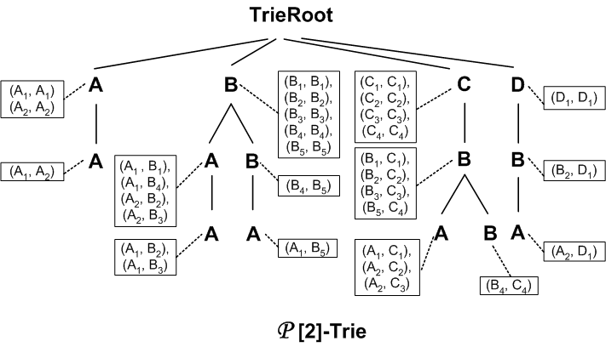
P[k]-Trie Index
Keep track of the P[k]-partitions
Use the reverse label path as key
P [2] | (A) (B) (C) (D) | {(A₁, A₁), (A₂, A₂)} {(B₁, B₁), (B₂, B₂), (B₃, B₃), (B₄, B₄), (B₅, B₅)} {(C₁, C₁), (C₂, C₂), (C₃, C₃), (C₄, C₄)} {(D₁, D₁)}
 | (A,A) (A,B) (B,B) (B,C) (B,D) | {(A₁, A₂)} {(A₁, B₁), (A₂, B₂), (A₂, B₃), (A₁, B₄)} {(B₄, B₅)} {(B₁, C₁), (B₂, C₂), (B₃, C₃), (B₅, C₄)} {(B₂, D₁)}
 | (A,A,B) (A,B,B) (A,B,C) (A,B,D) (B,B,C) | {(A₁, B₂), (A₁, B₃)} {(A₁, B₅)} {(A₁, C₁), (A₂, C₂), (A₂, C₃)} {(A₂, D₁)} {(B₄, C₄)}

Slide 43
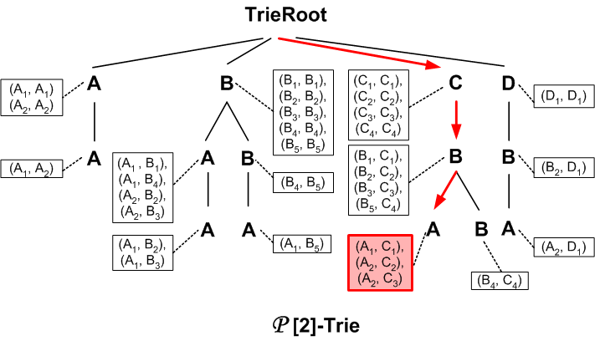
Query Evaluation with P[k]-Trie Index
Query 1: //A/B/C

Slide 44
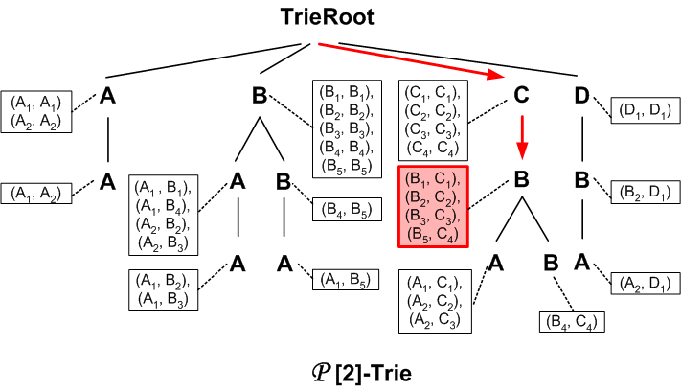
Query Evaluation with P[k]-Trie Index
Query 2: //B/C

Slide 45

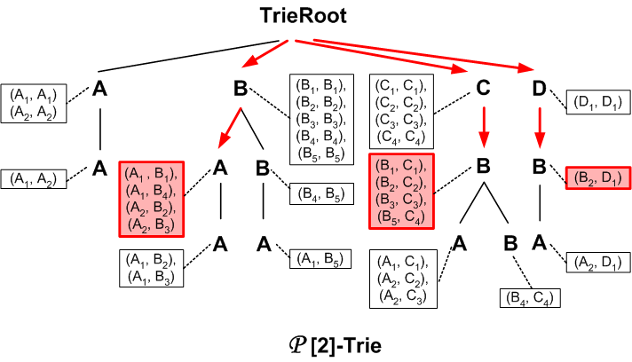
Query Evaluation with P[k]-Trie Index
Query 3: //A/B[./D]/C

Slide 46

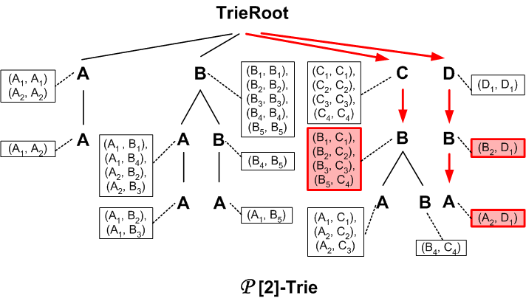
Query Evaluation with P[k]-Trie Index
Query 3: //A/B[./D]/C

